Slide 1
Convolutional Neural Networks

Slide 2
Neural networks
NN are a subset of machine learning, and they are at the heart of deep learning algorithms.
They are comprised of node layers, containing an input layer, one or more hidden layers, and an output layer.
Each node connects to another and has an associated weight and threshold.
If the output of any individual node is above the specified threshold value, that node is activated, sending data to the next layer of the network.
Otherwise, no data is passed along to the next layer of the network.

Slide 3
Convolutional neural networks
Convolutional neural networks (ConvNets or CNNs) are more often utilized for classification and computer vision tasks.
Prior to CNNs, manual, time-consuming feature extraction methods were used to identify objects in images.
However, convolutional neural networks now provide a more scalable approach to image classification and object recognition tasks, leveraging principles from linear algebra, specifically matrix multiplication, to identify patterns within an image.
They are specialized for data having grid-like topology 1D grid – time series data ;2D grid – image data

Slide 4
The name “convolutional neural network” indicates that the network employs a mathematical operation called convolution.
Convolution is a specialized kind of linear operation.
Convolutional networks are simply neural networks that use convolution in place of general matrix multiplication in at least one of their layers.

Slide 5
The Convolution Operation
Convolution is an operation on two functions of a real valued argument.
Examples:
Tracking the location of a spaceship with a laser sensor.
Laser sensor provides a single output x(t), the position of the spaceship at time t. Both x and t are real-valued, i.e., we can get a different reading from the laser sensor at any instant in time.
Suppose that laser sensor is somewhat noisy. To obtain a less noisy estimate of the spaceship’s position, we would like to average together several measurements.
More recent measurements are more relevant, so we will want this to be a weighted average that gives more weight to recent measurements.

Slide 6
We can do this with a weighting function w(a), where a is the age of a measurement. If we apply such a weighted average operation at every moment, we obtain a new function providing s a smoothed estimate of the position of the spaceship.
s(t) = ∫ x(a) w(t − a) da
This operation is called convolution. The convolution operation is typically denoted with an asterisk:
s(t) = (x ∗ w)(t)
In the example, w needs to be a valid probability density function, or the output is not a weighted average. Also, w needs to be 0 for all negative arguments.

Slide 7
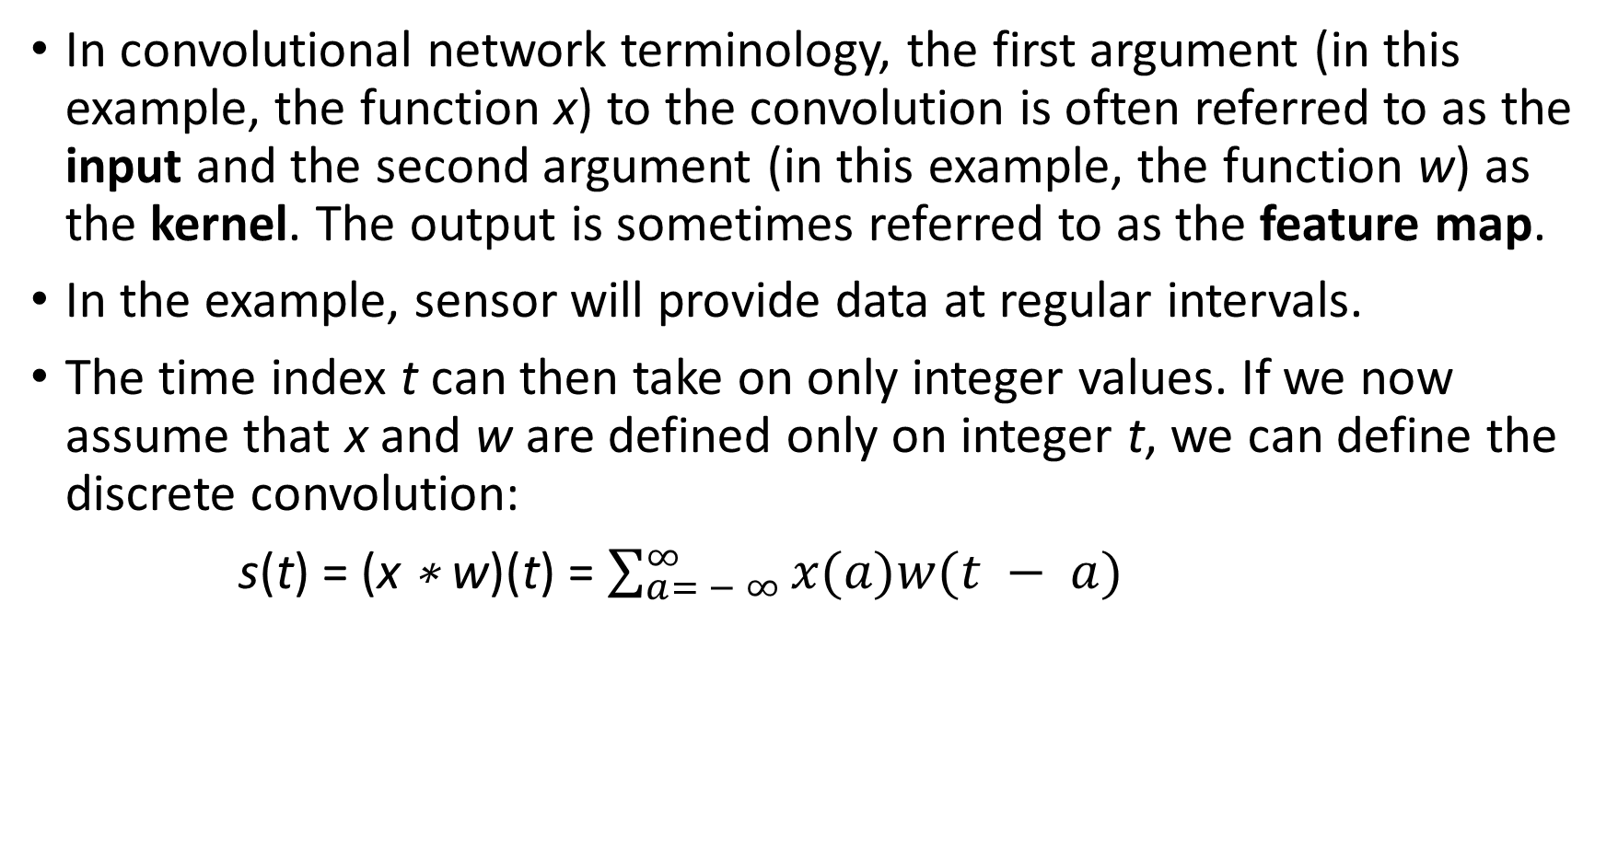
In convolutional network terminology, the first argument (in this example, the function x) to the convolution is often referred to as the input and the second argument (in this example, the function w) as the kernel. The output is sometimes referred to as the feature map.
In the example, sensor will provide data at regular intervals.
The time index t can then take on only integer values. If we now assume that x and w are defined only on integer t, we can define the discrete convolution:
s(t) = (x ∗ w)(t) = $\sum_{a= − ∞}^{∞}{x(a)w(t − a)}$

Slide 8
Tensors
In machine learning applications, the input is usually a multidimensional array of data and the kernel is usually a multidimensional array of parameters that are adapted by the learning algorithm.
These multidimensional arrays are referred as tensors, because each element of the input and kernel must be explicitly stored separately.
We usually assume that these functions are zero everywhere but the finite set of points for which we store the values.
This means that in practice we can implement the infinite summation as a summation over a finite number of array elements.

Slide 9
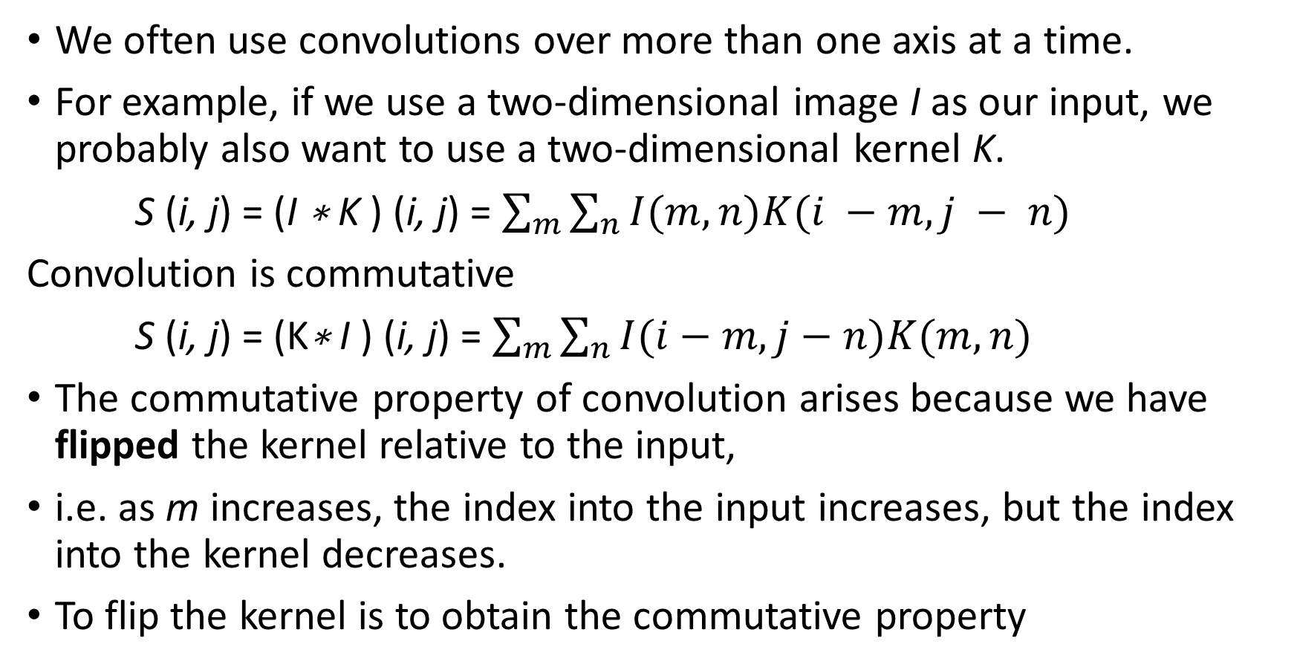
We often use convolutions over more than one axis at a time.
For example, if we use a two-dimensional image I as our input, we probably also want to use a two-dimensional kernel K.
S (i, j) = (I ∗ K ) (i, j) = $\sum_{m}{\sum_{n}{I(m, n)K(i −m, j − n)}}$
Convolution is commutative
S (i, j) = (K∗ I ) (i, j) = $\sum_{m}{\sum_{n}{I(i−m, j−n)K(m, n)}}$
The commutative property of convolution arises because we have flipped the kernel relative to the input,
i.e. as m increases, the index into the input increases, but the index into the kernel decreases.
To flip the kernel is to obtain the commutative property

Slide 10
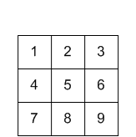
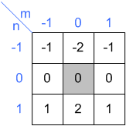
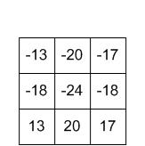
input
kernel
output

Slide 11
calculate each sample of the output one by one.
First, flip the kernel, which is the shaded box, in both horizontal and vertical direction.
Then, move it over the input array. If the kernel is centered (aligned) exactly at the sample that we are interested in, multiply the kernel data by the overlapped input data.
The accumulation (adding these 9 multiplications) is the last thing to do to find out the output value.

Slide 12
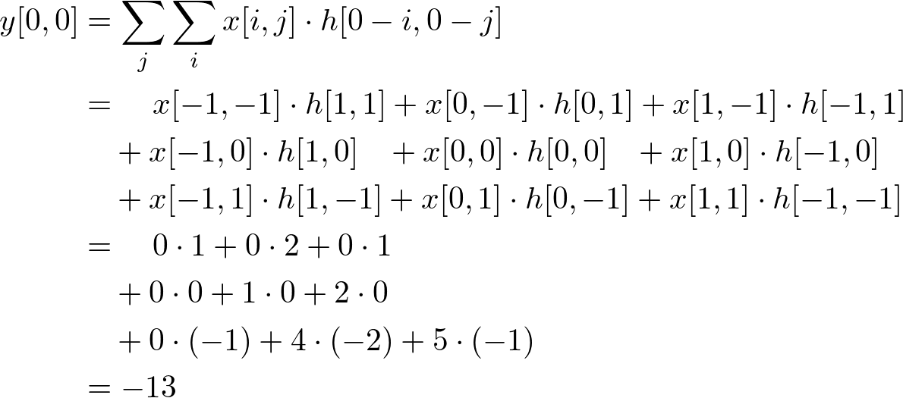
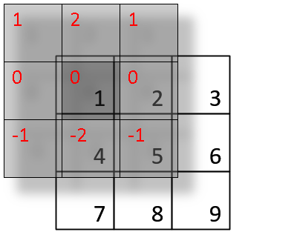

Slide 13
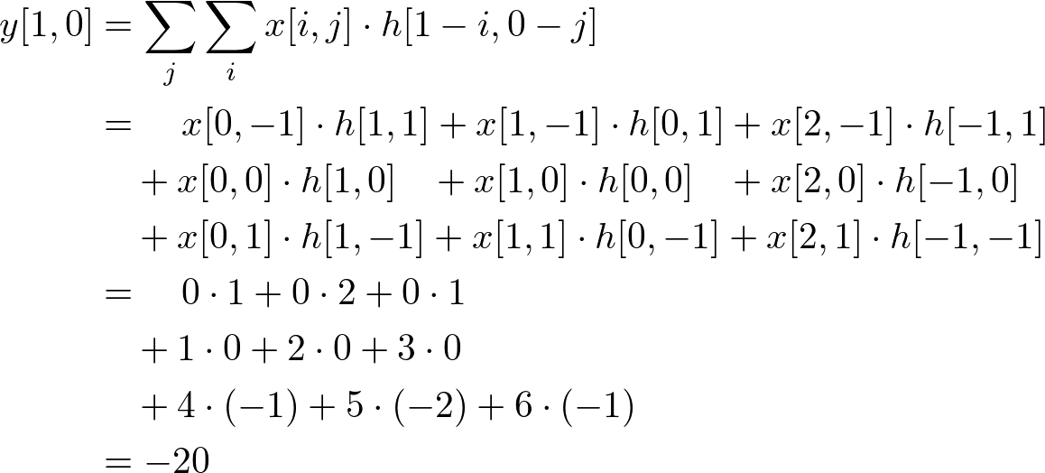
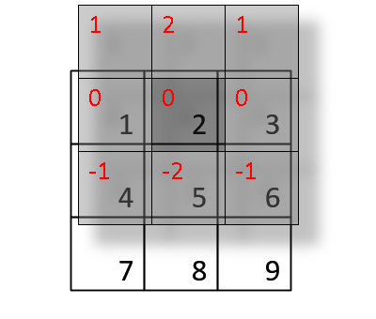

Slide 14
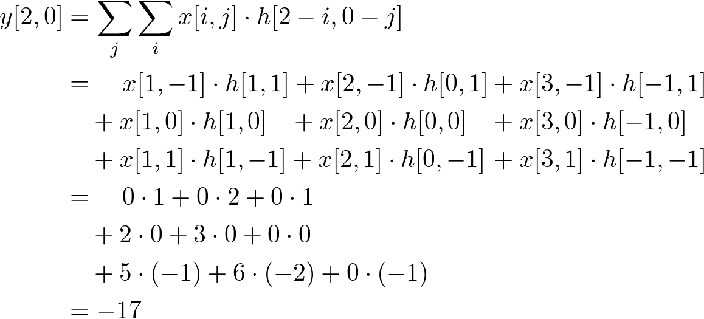
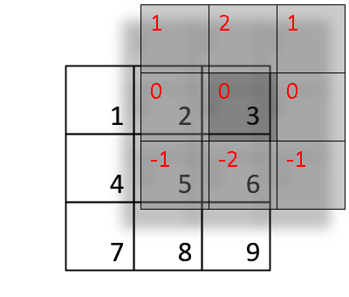

Slide 15
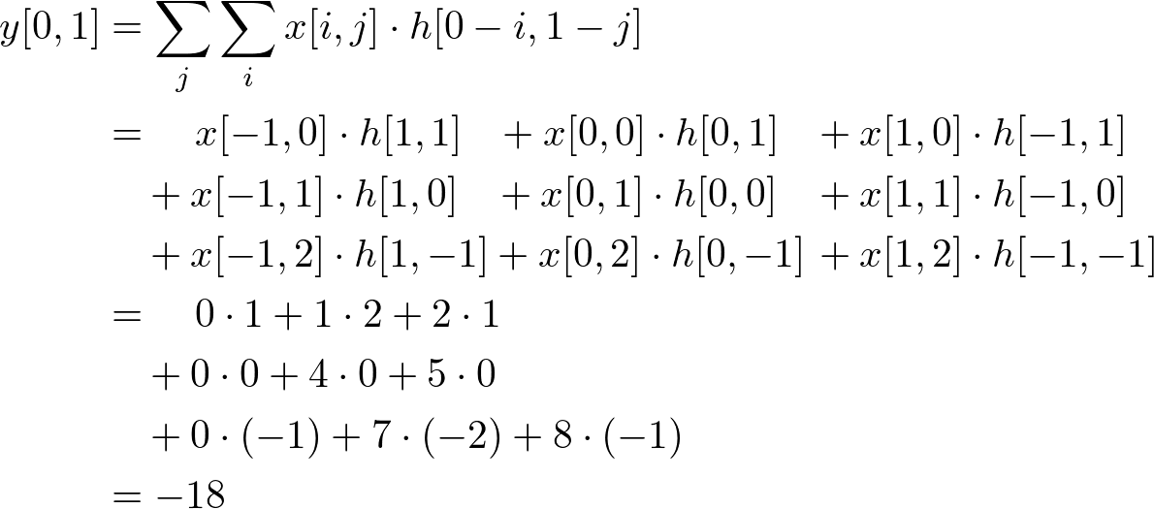
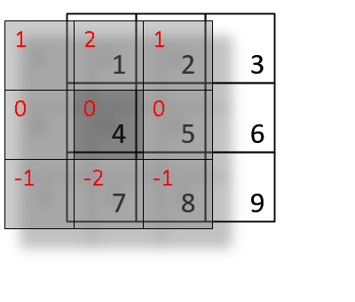

Slide 16
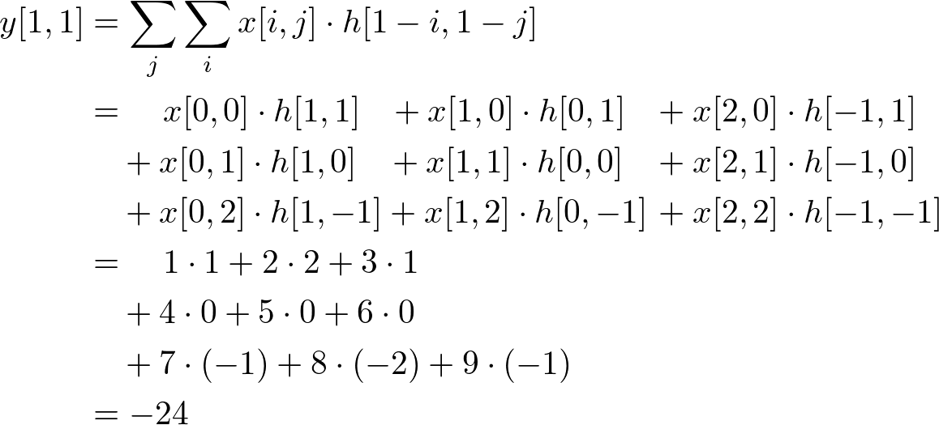
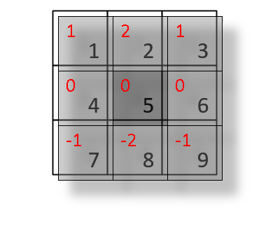

Slide 17
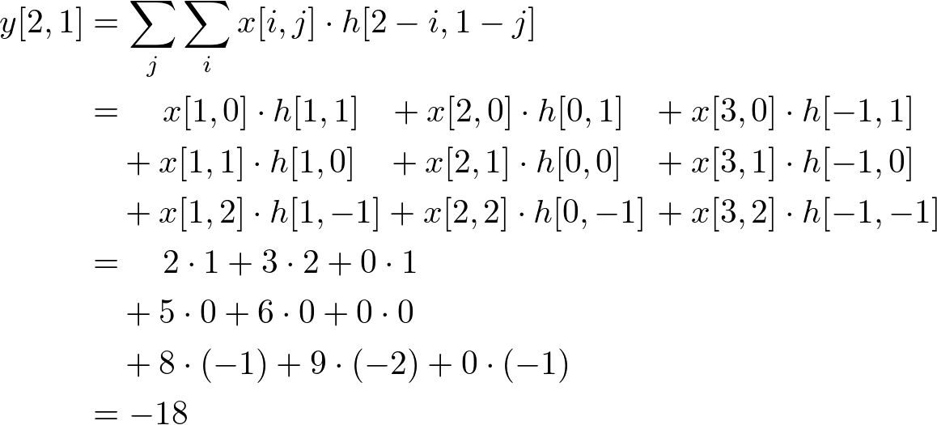
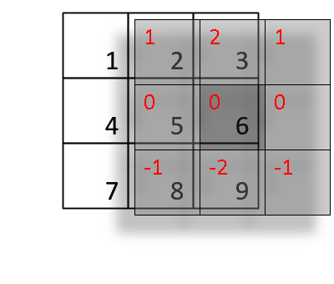

Slide 18
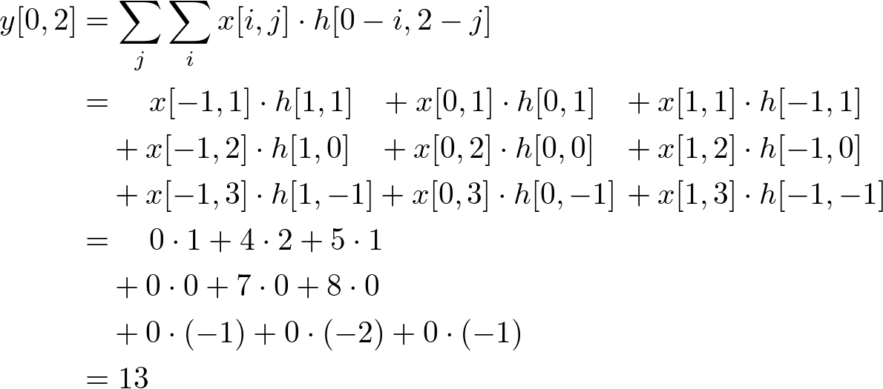
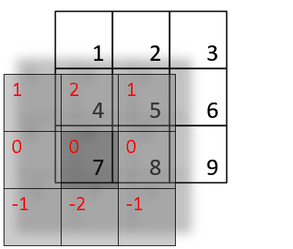

Slide 19
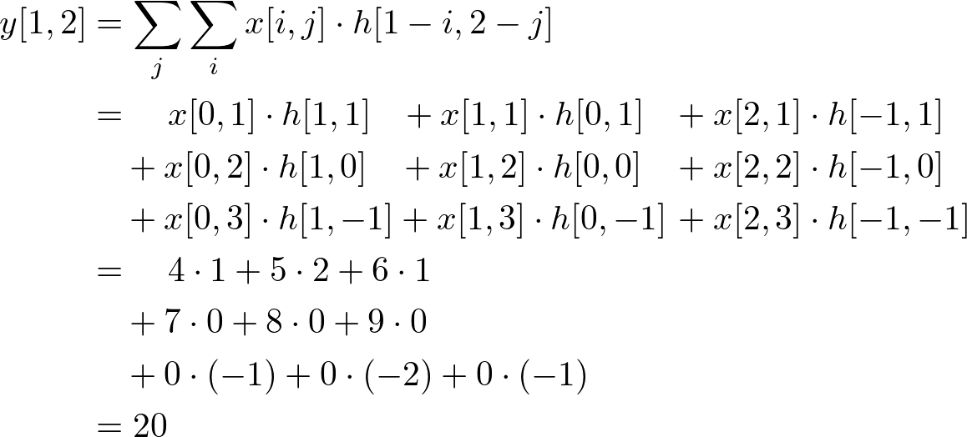
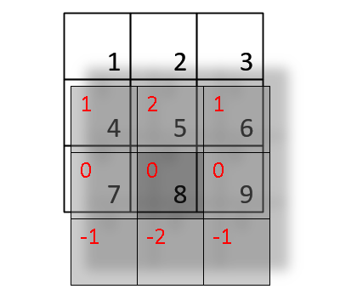

Slide 20
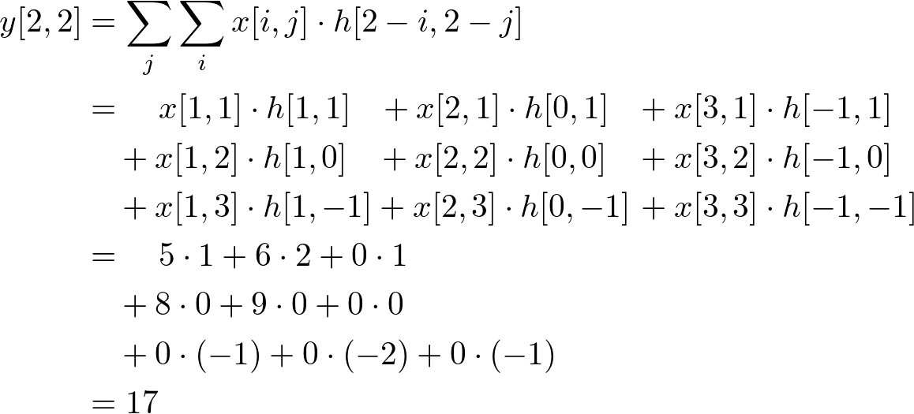
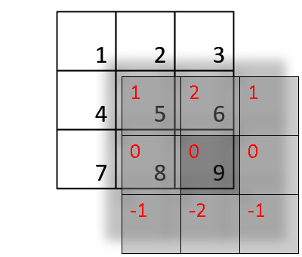

Slide 21
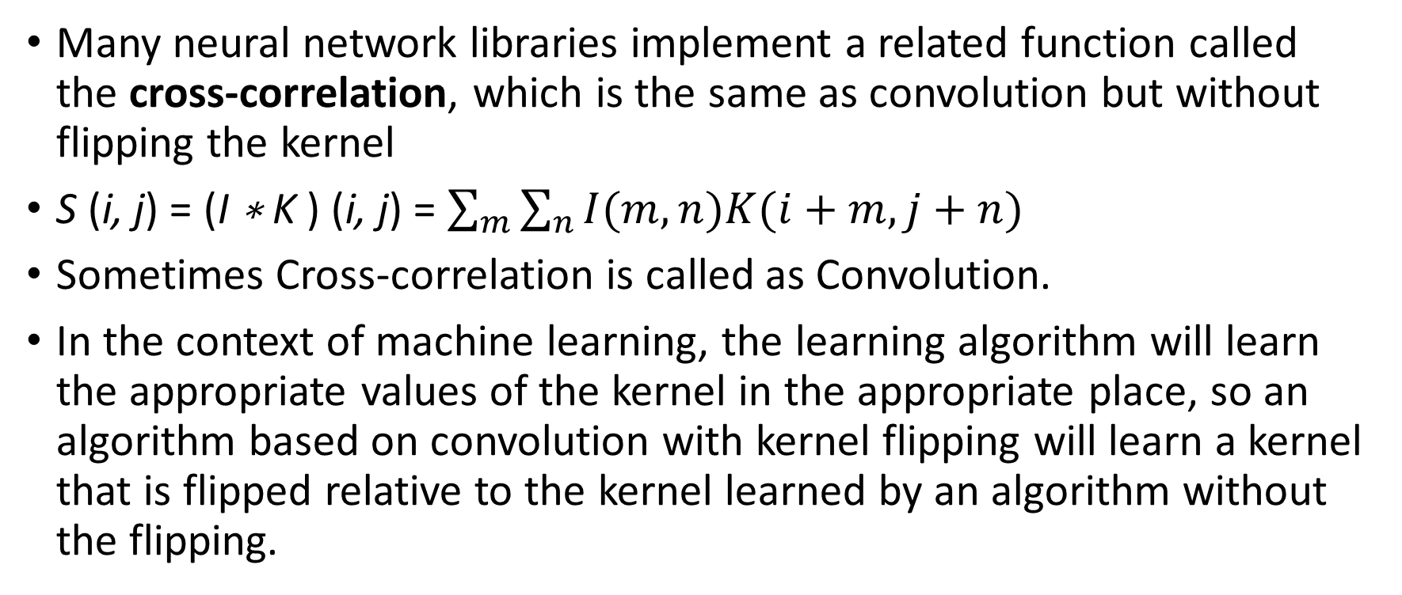
Many neural network libraries implement a related function called the cross-correlation, which is the same as convolution but without flipping the kernel
S (i, j) = (I ∗ K ) (i, j) = $\sum_{m}{\sum_{n}{I(m, n)K(i+m, j+n)}}$
Sometimes Cross-correlation is called as Convolution.
In the context of machine learning, the learning algorithm will learn the appropriate values of the kernel in the appropriate place, so an algorithm based on convolution with kernel flipping will learn a kernel that is flipped relative to the kernel learned by an algorithm without the flipping.

Slide 22
Input kernel
Output
a | b | c | d
e | f | g | h
i | j | k | l
w | x
y | z
aw + bx + ey + fz | bw + cx + fy + gz | cw + dx + gy + hz
ew + fx + iy + jz | fw + gx+ jy+ kz | gw + hx + ky + lz

Slide 23
Key Idea
Replace matrix multiplication in neural nets with convolution
Everything else stays the same
Maximum likelihood
Back-propagation etc.

Slide 24
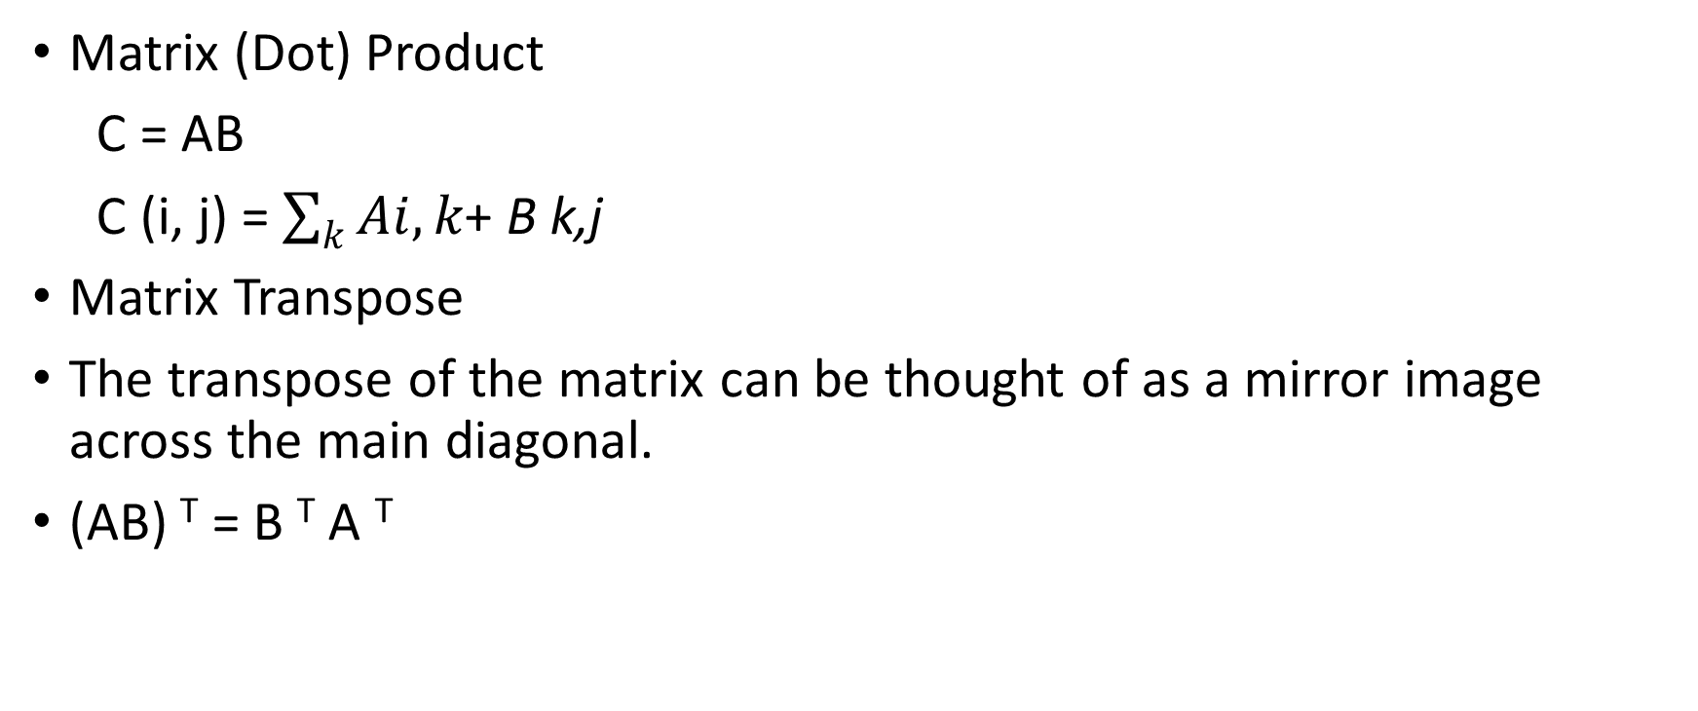
Matrix (Dot) Product
C = AB
C (i, j) = $\sum_{k}{Ai,k\text{+ }\text{B} \text{k}\text{,}\text{j}}$
Matrix Transpose
The transpose of the matrix can be thought of as a mirror image across the main diagonal.
(AB) ^{T} = B ^{T} A ^{T}

Slide 25
Three Operations
Convolution: like matrix multiplication
Take an input, produce an output (hidden layer)
Deconvolution: like multiplication by transpose of a matrix
  Used to back-propagate error from output to input
  Reconstruction in autoencoder / RBM
Weight gradient computation
  Used to back propagate error from output to weights
  Accounts for the parameter sharing

Slide 26
Convolution leverages three important ideas that can help improve a machine learning system:
  sparse interactions
  parameter sharing
  equivariant representations.

Slide 27
Sparse interactions
Traditional neural network layers use matrix multiplication by a matrix of parameters with a separate parameter describing the interaction between each input unit and each output unit.
This means every output unit interacts with every input unit.
Convolutional networks, however, typically have sparse interactions (also referred to as sparse connectivity or sparse weights).
This is accomplished by making the kernel smaller than the input.

Slide 28
For example, when processing an image, the input image might have thousands or millions of pixels, but we can detect small, meaningful features such as edges with kernels that occupy only tens or hundreds of pixels.
This means that we need to store fewer parameters, which both reduces the memory requirements of the model and improves its statistical efficiency.
It also means that computing the output requires fewer operations.

Slide 29
If there are m inputs and n outputs, then matrix multiplication requires m×n parameters and the algorithms used in practice have O(m × n) runtime (per example).
If we limit the number of connections each output may have to k, then the sparsely connected approach requires only k × n parameters and O(k × n) runtime.

Slide 30
Top - When s is formed by convolution with a kernel of width 3, only three outputs are affected by x.
(Bottom)When s is formed by matrix multiplication, connectivity is no longer sparse, so all of the outputs are affected by x3.

Slide 31
Parameter sharing
Parameter sharing refers to using the same parameter for more than one function in a model.
In a traditional neural net, each element of the weight matrix is used exactly once when computing the output of a layer.
It is multiplied by one element of the input and then never revisited.
As a synonym for parameter sharing, one can say that a network has tied weights, because the value of the weight applied to one input is tied to the value of a weight applied elsewhere.

Slide 32
In a convolutional neural net, each member of the kernel is used at every position of the input (except perhaps some of the boundary pixels, depending on the design decisions regarding the boundary).
The parameter sharing used by the convolution operation means that rather than learning a separate set of parameters for every location, we learn only one set.
This does not affect the runtime of forward propagation—it is still
O(k × n)—but it does further reduce the storage requirements of the model to k parameters.

Slide 33
How sparse connectivity and parameter sharing can dramatically improve the efficiency of a linear function for detecting edges in an image.
Example:
Efficiency of edge detection

Slide 34
Input
Output
1 | -1
Kernel

Slide 35
The image on the right was formed by taking each pixel in the original image and subtracting the value of its neighboring pixel on the left.
This shows the strength of all of the vertically oriented edges in the input image, which can be a useful operation for object detection.
Both images are 280 pixels tall.
The input image is 320 pixels wide while the output image is 319 pixels wide.
This transformation can be described by a convolution kernel containing two elements, and requires 319 × 280 × 3 = 267,960 floating point operations (two multiplications and one addition per output pixel) to compute using convolution.

Slide 36
To describe the same transformation with a matrix multiplication would take 320 × 280 × 319 × 280, or over eight billion, entries in the matrix, making convolution four billion times more efficient for representing this transformation.
The straightforward matrix multiplication algorithm performs over sixteen billion floating point operations, making convolution roughly 60,000 times more efficient computationally, even though most of the entries of the matrix would be zero.
If we stored only the nonzero entries of the matrix, then both matrix multiplication and convolution would require the same number of floating point operations to compute.
The matrix would still need to contain 2 × 319 × 280 = 178, 640 entries.
Convolution is an extremely efficient way of describing transformations that apply the same linear transformation of a small, local region across the entire input.

Slide 37
Equivariant representations
In the case of convolution, the particular form of parameter sharing causes the layer to have a property called equivariance to translation.
To say a function is equivariant means that if the input changes, the output changes in the same way.
Specifically, a function f (x) is equivariant to a function g if f(g(x)) = g(f (x)).
In the case of convolution, if we let g be any function that translates the input, i.e., shifts it, then the convolution function is equivariant to g.

Slide 38
When processing time series data, this means that convolution produces a sort of timeline that shows when different features appear in the input.
If we move an event later in time in the input, the exact same representation of it will appear in the output, just later in time.
Similarly with images, convolution creates a 2-D map of where certain features appear in the input.
If we move the object in the input, its representation will move the same amount in the output. This is useful for when we know that some function of a small number of neighboring pixels is useful when applied to multiple input locations.

